Slide 1
Analysis of Categorical Data I
Statistical Data Analysis, 2023

Slide 2
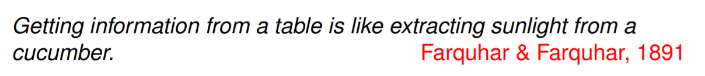
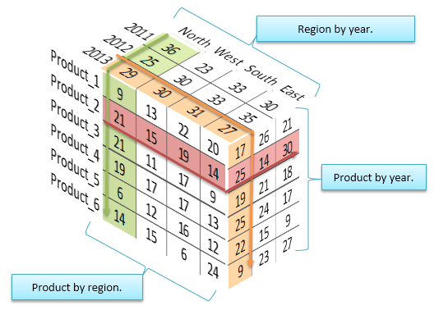

Slide 3
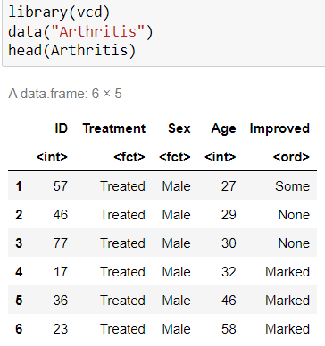
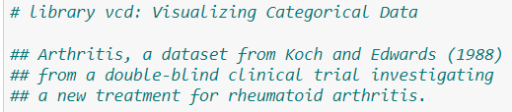
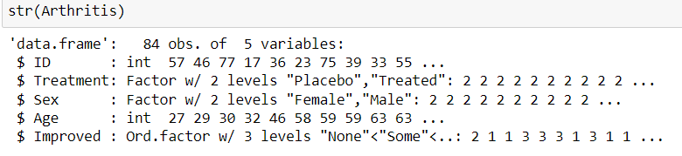
Example: Arthritis (关节炎数据)
Notes:
Notice which attributes are factors.
Factors of interest: treatment and improved

Slide 4


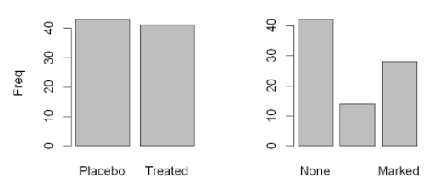
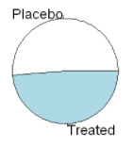
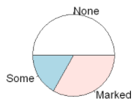
Example: Arthritis
R: table(), barplot(), pie()
Notes:
Factors to consider: treatment and improved.

Slide 5
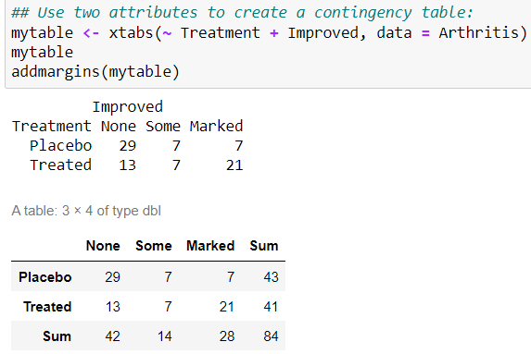
Two-way contingency table (二阶列联表)
R: xtabs() to create a contingency table
← Frequency/count

Slide 6
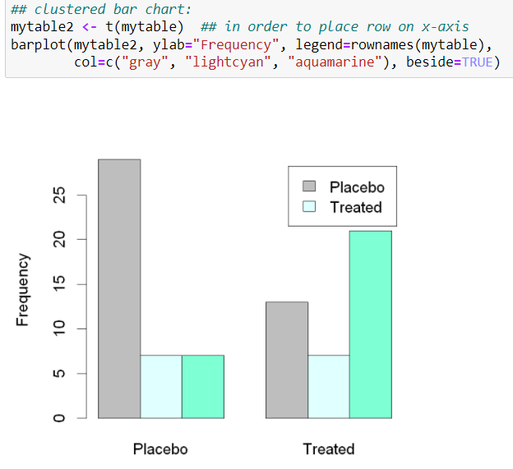
Two-way contingency table

Slide 7
Possible Sampling Method in Use
Each cell is an independent count variable (from Poisson distribution)
Scenario: Patients randomly arrive, which are then randomly distributed to the Placebo or Treatment group
Poisson Sampling
The total sample size was specified before the experiment
Frequency in a cell: the realization of a r.v. with a multinomial distribution under a fixed total number
Multinomial Sampling
The size of the Placebo or Treated group was specified before the experiment
Independent Binomial or Multinomial Sampling
Notes:
Same table may come from different sampling method, which has different interpretation.
But interestingly, that can all be analyzed by Chi-square test here.

Slide 8

单选题
1分
A company wants to investigate the relationship between employee gender and job satisfaction. The team leader divides job satisfaction into several levels, and investigates the views of 100 male and 100 female employees, respectively.
Q: What kind of sampling method is being used?
A
Poisson Sampling
B
Multinomial Sampling
C
Independent Multinomial Sampling
提交
Notes:
Answer: C

Slide 9
Chi-squared Test of Independence (卡方独立性检验)

Slide 10
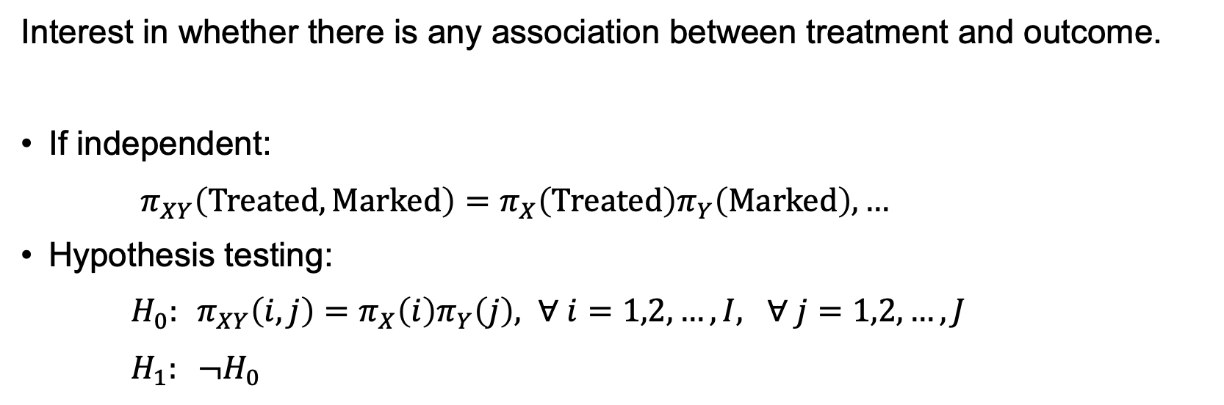
Testing for Independence in Two-Way Tables
Interest in whether there is any association between treatment and outcome.
If independent:
$π_{XY}\left(Treated, Marked\right)=π_{X}\left(Treated\right)π_{Y}\left(Marked\right),…$
Hypothesis testing:
$H_{0}:$ $π_{XY}\left(i,j\right)=π_{X}\left(i\right)π_{Y}\left(j\right), ∀ i=1,2,…,I, ∀ j=1,2,…,J$
$H_{1}: ¬H_{0}$

Slide 11
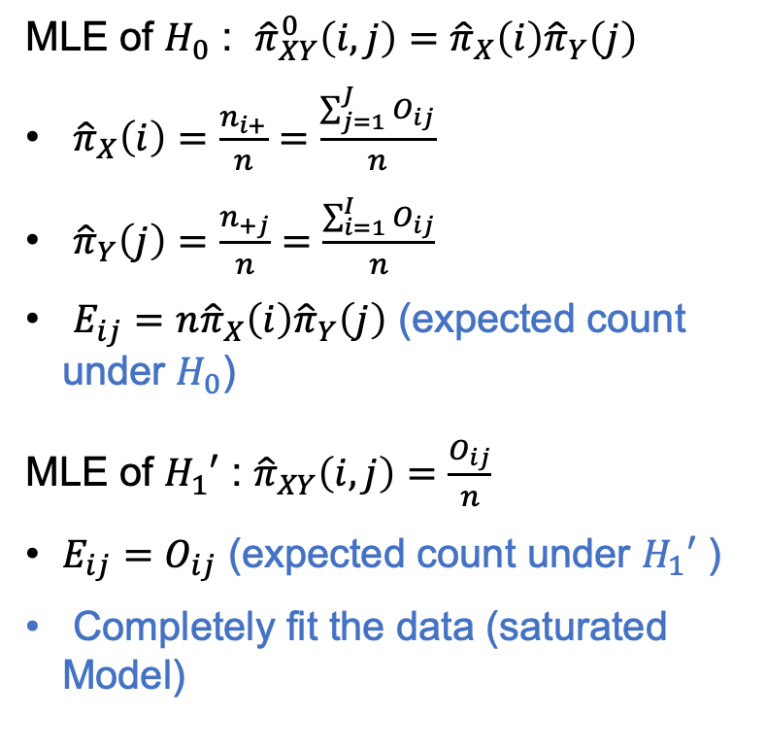
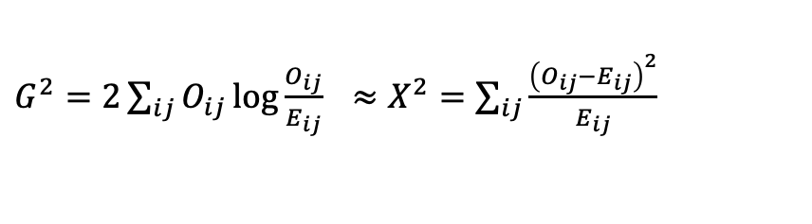
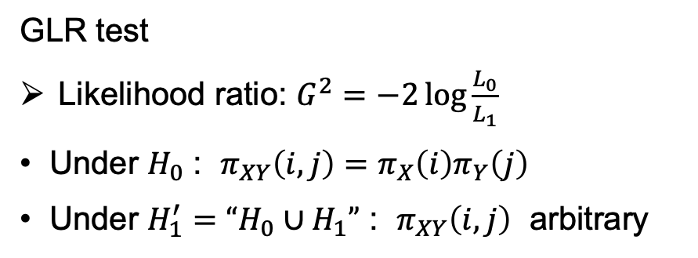
Testing for Independence in Two-Way Tables
MLE of $H_{0}$ : ${\hat{π}}_{XY}^{0}\left(i,j\right)={\hat{π}}_{X}\left(i\right){\hat{π}}_{Y}\left(j\right)$
${\hat{π}}_{X}\left(i\right)=\frac{n_{i+}}{n}=\frac{\sum_{j=1}^{J}{O_{ij}}}{n}$
${\hat{π}}_{Y}\left(j\right)=\frac{n_{+j}}{n}=\frac{\sum_{i=1}^{I}{O_{ij}}}{n}$
$E_{ij}=n{\hat{π}}_{X}\left(i\right){\hat{π}}_{Y}\left(j\right)$ (expected count under $H_{0}$)
MLE of $H_{1}′$ : ${\hat{π}}_{XY}\left(i,j\right)=\frac{O_{ij}}{n}$
$E_{ij}=O_{ij}$ (expected count under $H_{1}′$ )
Completely fit the data (saturated Model)
GLR test
Likelihood ratio: $G^{2}=−2\log{\frac{L_{0}}{L_{1}}}$
Under $H_{0}$ : $π_{XY}\left(i,j\right)=π_{X}\left(i\right)π_{Y}\left(j\right)$
Under $H_{1}^{′}=“H_{0}∪H_{1}”$ : $π_{XY}\left(i,j\right)$ arbitrary
$G^{2}=2\sum_{ij}{O_{ij}\log{\frac{O_{ij}}{E_{ij}}}}$ $≈X^{2}=\sum_{ij}{\frac{{\left(O_{ij}−E_{ij}\right)}^{2}}{E_{ij}}}$
Chi-square test

Slide 12
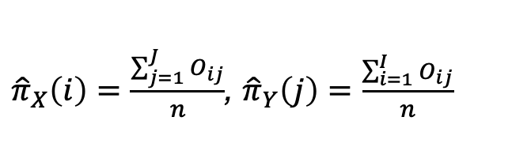
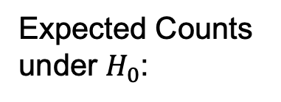

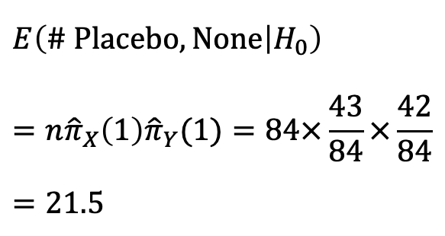
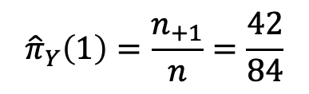
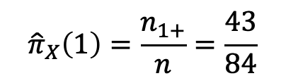
Expected Counts under $H_{0}$
 | Improved
Treatment | None | Some | Marked | Total
Placebo | 29 | 7 | 7 | 43
Treated | 13 | 7 | 21 | 41
Total | 42 | 14 | 28 | 84
$${\hat{π}}_{X}\left(1\right)=\frac{n_{1+}}{n}=\frac{43}{84}$$
$${\hat{π}}_{Y}\left(1\right)=\frac{n_{+1}}{n}=\frac{42}{84}$$
$$E\left(\# Placebo,None | H_{0}\right)=n{\hat{π}}_{X}\left(1\right){\hat{π}}_{Y}(1)=84×\frac{43}{84}×\frac{42}{84}=21.5$$
Expected Counts under $H_{0}$:
${\hat{π}}_{X}\left(i\right)=\frac{\sum_{j=1}^{J}{O_{ij}}}{n}$, ${\hat{π}}_{Y}\left(j\right)=\frac{\sum_{i=1}^{I}{O_{ij}}}{n}$

Slide 13
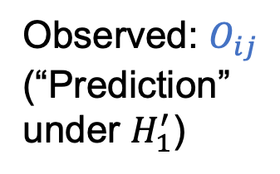
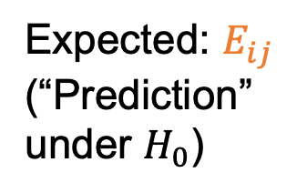
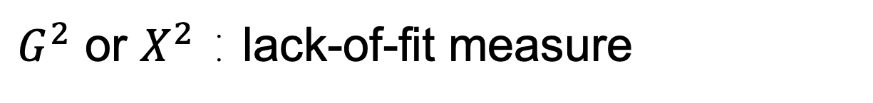

$G^{2}$ or $X^{2}$：lack-of-fit measure
O | Improved
Treatment | None | Some | Marked | Total
Placebo | 29 | 7 | 7 | 43
Treated | 13 | 7 | 21 | 41
Total | 42 | 14 | 28 | 84
Observed: $O_{ij}$
(“Prediction” under $H_{1}^{′}$)
$E\left(\# Placebo,None | H_{0}\right)=n{\hat{π}}_{X}\left(1\right){\hat{π}}_{Y}(1)=84×\frac{43}{84}×\frac{42}{84}=21.5$, …
E | Improved
Treatment | None | Some | Marked | Total
Placebo | 21.5 | 7.166667 | 14.33333 | 43
Treated | 20.5 | 6.833333 | 13.66667 | 41
Total | 42 | 14 | 28 | 84
Expected: $E_{ij}$
(“Prediction” under $H_{0}$)
$$X^{2}=\frac{{\left(29−21.5\right)}^{2}}{21.5}+\frac{{\left(13−20.5\right)}^{2}}{20.5}+…=13.055$$
Notes:
Need a cut-off value for deciding whether independence model provides a good fit or not.

Slide 14
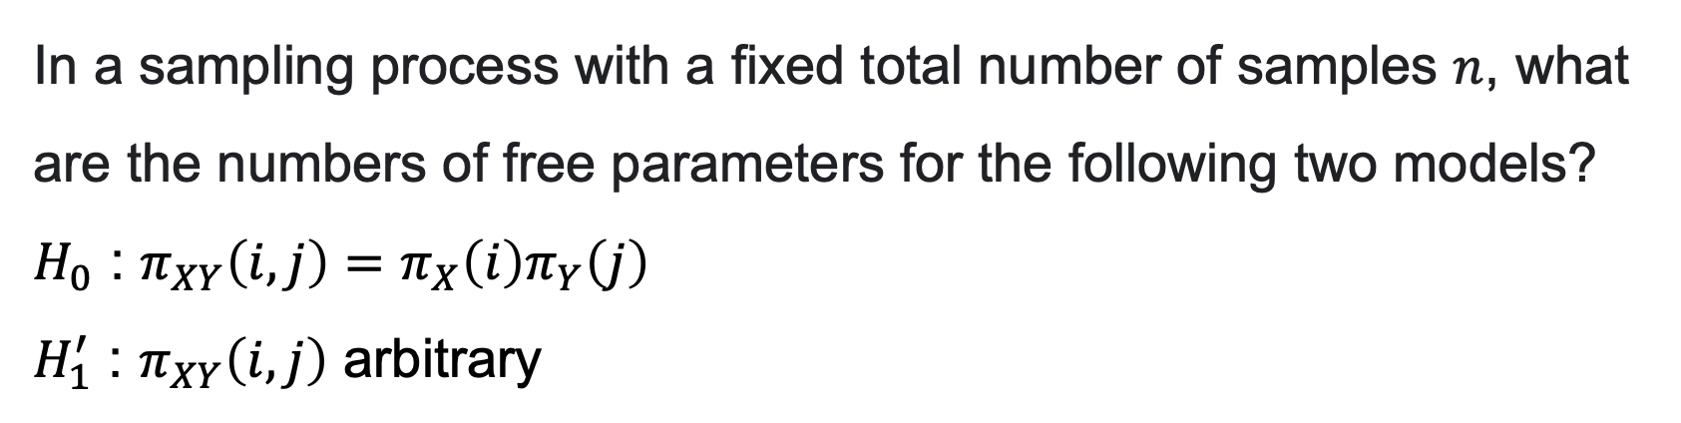
单选题
1分
In a sampling process with a fixed total number of samples $n$, what are the numbers of free parameters for the following two models?
$H_{0}$ : $π_{XY}\left(i,j\right)=π_{X}\left(i\right)π_{Y}\left(j\right)$
$H_{1}^{′}$ : $π_{XY}\left(i,j\right)$ arbitrary
A
${df(H}_{0})=I+J$, ${df(H}_{1}′)=IJ$
B
${df(H}_{0})=(I−1)+(J−1)$, ${df(H}_{1}′)=IJ−1$
C
${df(H}_{0})=I+J$, ${df(H}_{1}′)=IJ−1$
提交
Notes:
Answer: B

Slide 15
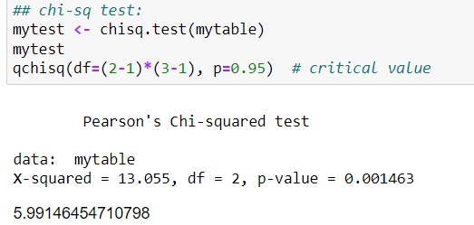
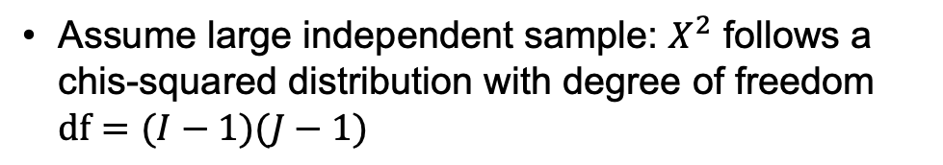
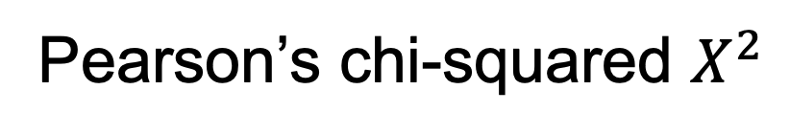
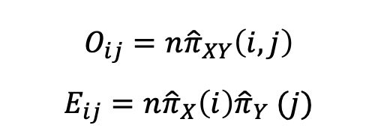
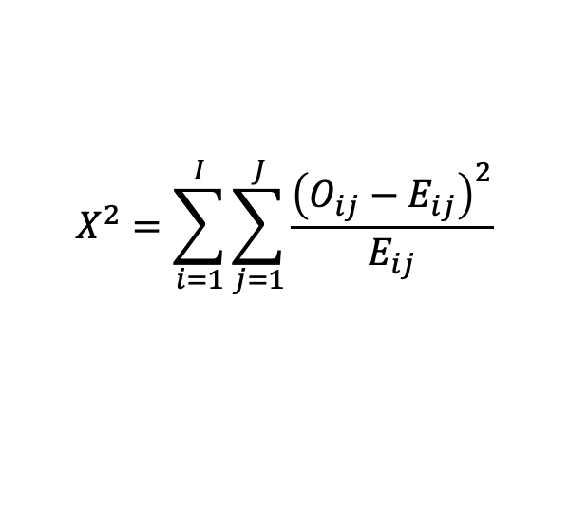
Pearson’s chi-squared $X^{2}$
$$X^{2}=\sum_{i=1}^{I}{\sum_{j=1}^{J}{\frac{{\left(O_{ij}−E_{ij}\right)}^{2}}{E_{ij}}}}$$
$$O_{ij}=n{\hat{π}}_{XY}\left(i,j\right)$$
$$E_{ij}=n{\hat{π}}_{X}\left(i\right){\hat{π}}_{Y} (j)$$
Assume large independent sample: $X^{2}$ follows a chis-squared distribution with degree of freedom $df=(I−1)(J−1)$
Conclusion: At the significance level of 0.01, the null hypothesis is rejected.
(p-value = 0.001463)
Notes:
Remind for GLR: df = dim(H1’) – dim(H0)
Independent sample: require the experiment to be well conducted
Large sample: count in each cell cannot be too small

Slide 16
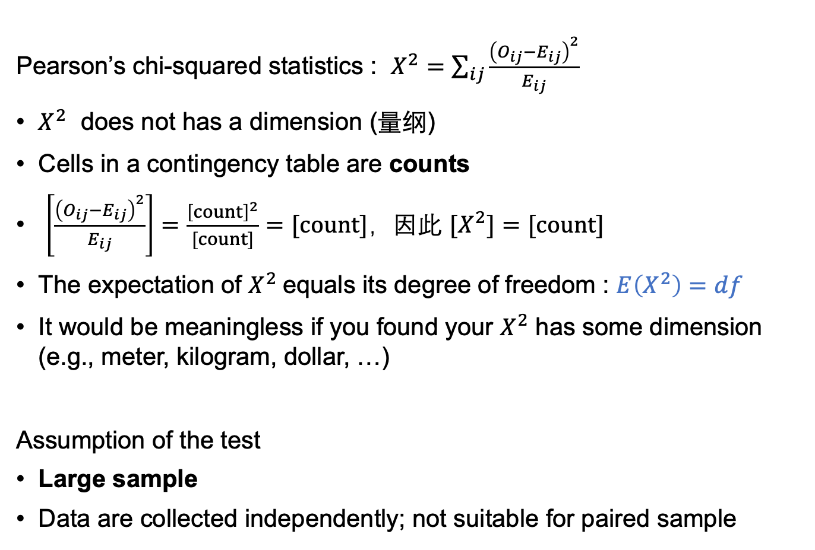
Some Discussion
Pearson’s chi-squared statistics : $X^{2}=\sum_{ij}{\frac{{\left(O_{ij}−E_{ij}\right)}^{2}}{E_{ij}}}$
$X^{2}$ does not has a dimension (量纲)
Cells in a contingency table are counts
$\left[\frac{{\left(O_{ij}−E_{ij}\right)}^{2}}{E_{ij}}\right]=\frac{{\left[count\right]}^{2}}{[count]}=[count]$，因此 $[X^{2}]=[count]$
The expectation of $X^{2}$equals its degree of freedom : $E\left(X^{2}\right)=df$
It would be meaningless if you found your $X^{2}$ has some dimension (e.g., meter, kilogram, dollar, …)
Assumption of the test
Large sample
Data are collected independently; not suitable for paired sample
Notes:
Observe the expression of X2, why the denominator is Eij, but not Eij^2 ?

Slide 17
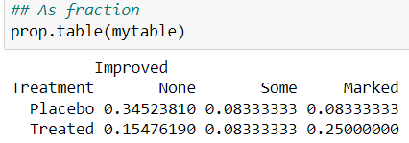
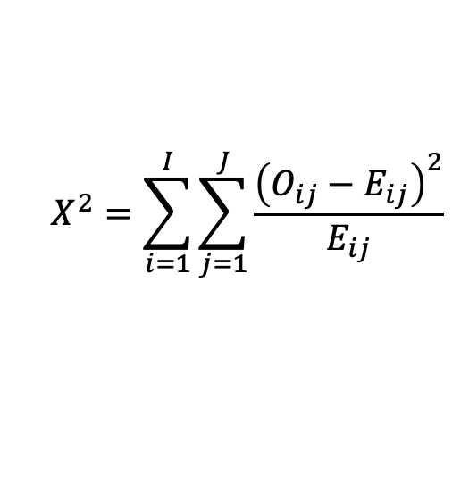
单选题
1分
Can we apply chisq.test() to the table?
A
Yes
$$X^{2}=\sum_{i=1}^{I}{\sum_{j=1}^{J}{\frac{{\left(O_{ij}−E_{ij}\right)}^{2}}{E_{ij}}}}$$
B
No
提交
Notes:
Answer: B

Slide 18
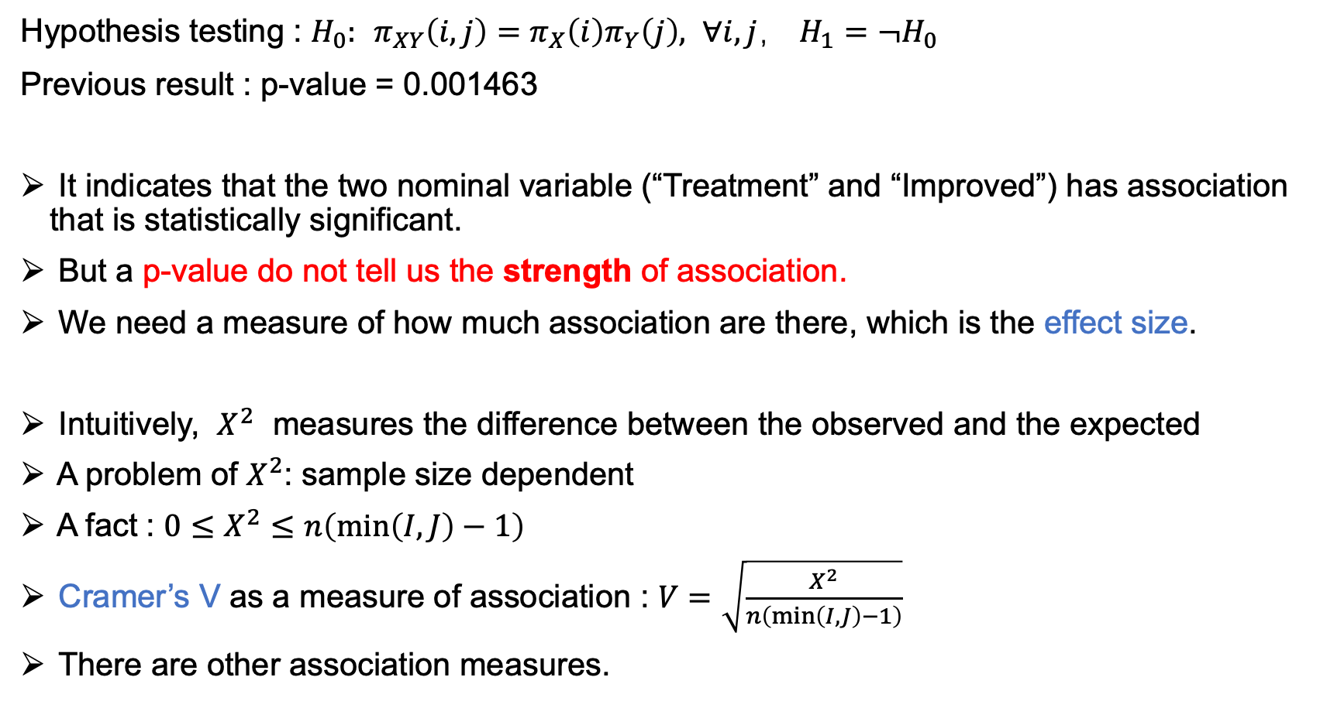
Effect Size (效应值)
Hypothesis testing : $H_{0}:$ $π_{XY}\left(i,j\right)=π_{X}\left(i\right)π_{Y}\left(j\right), ∀i,j$， $H_{1}=¬H_{0}$
Previous result : p-value = 0.001463
It indicates that the two nominal variable (“Treatment” and “Improved”) has association that is statistically significant.
But a p-value do not tell us the strength of association.
We need a measure of how much association are there, which is the effect size.
Intuitively, $X^{2}$ measures the difference between the observed and the expected
A problem of $X^{2}$: sample size dependent
A fact : $0≤X^{2}≤n\left(\min\left(I,J\right)−1\right)$
Cramer’s V as a measure of association : $V=\sqrt{\frac{X^{2}}{n\left(\min\left(I,J\right)−1\right)}}$
There are other association measures.

Slide 19
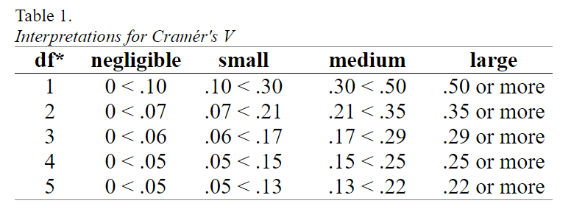
Effect Size
Similar to p-value, it is subjective to choose a cut-off effect size for strong or weak association.
Some rules of thumb exist in the literature.
For Cramer’s V，Cohen (1988) suggest the following:
Here, df* is not the degree of freedom of the chi-squared test, but $n\left(\min\left(I,J\right)−1\right)$.

Slide 20
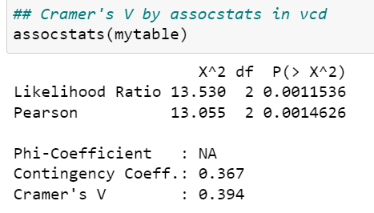

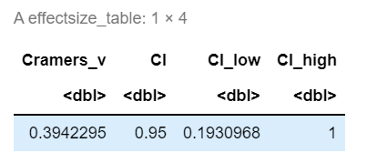
Effect Size
Outcome:
df* = min(2, 3) – 1 = 1,
Cramer’s V = 0.394，
Medium association

Slide 21
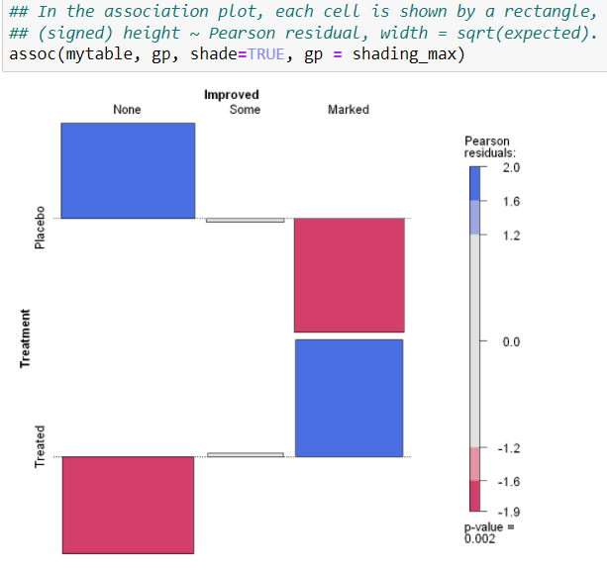
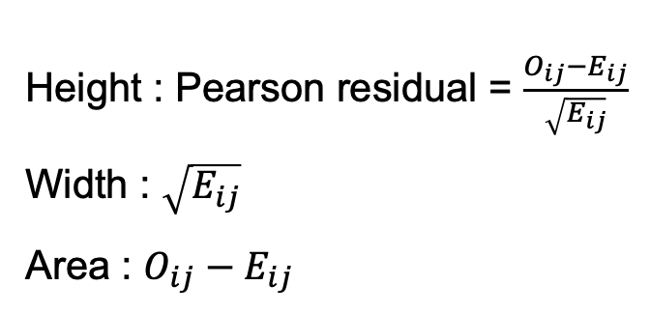
Association plot (vcd package)
Height : Pearson residual = $\frac{O_{ij}−E_{ij}}{\sqrt{E_{ij}}}$
Width : $\sqrt{E_{ij}}$
Area : $O_{ij}−E_{ij}$
Notes:
Contribution to X2 (lack-of-fit measure) from each cell.

Slide 22
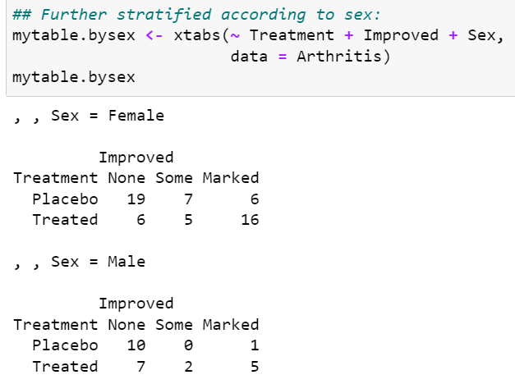
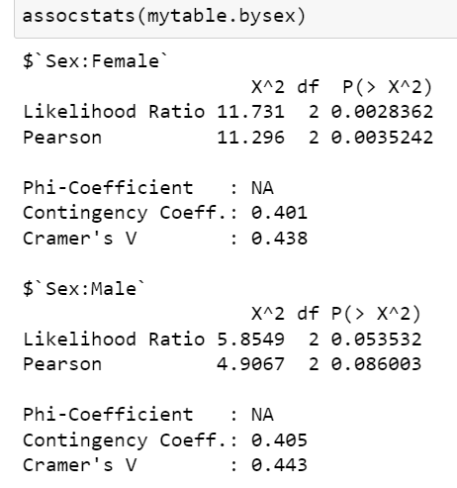
Effect of sex (性别)?
Stratified analysis:

Slide 23
投票
最多可选1项
Do you think the data supports the following statement or not:
“the Drugs work differently for different genders”?
A
Yes
B
No
提交

Slide 24
Stratified by sex
Some observation:
The association between “Treatment” and “ Improved” is more significant for female, comparing to male.
But the two group have similar effect sizes.
In fact, this is due to the small sample size of the male group.
Not enough statistical evidence to call a significance.

Slide 25
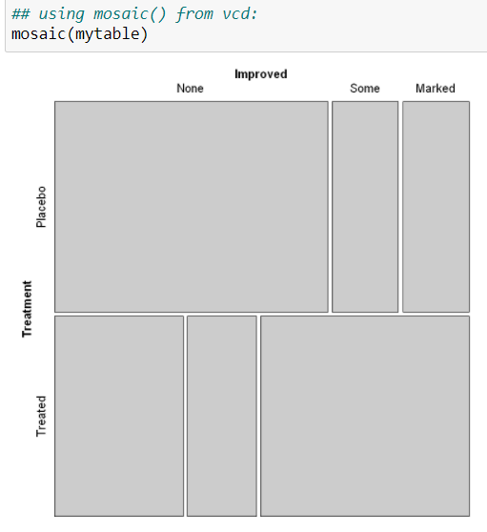
Better Visualization by Mosai Plot
Mosaic plot
like a grouped bar chart
the heights (or widths) of the bars show the relative frequencies of one variable
widths (heights) of the sections in each bar show the conditional frequencies of the second variable, given the first variable
gives an area-proportional visualization of the frequencies
can further super-impose the Pearson residual on each cell by color shading

Slide 26
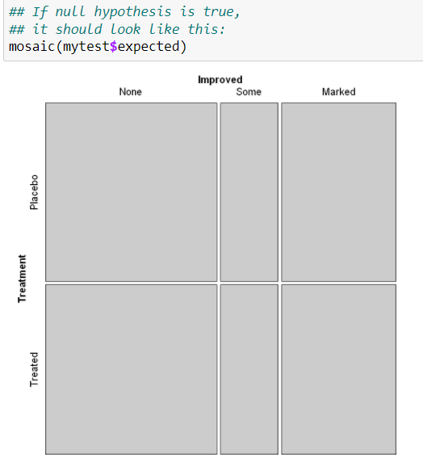
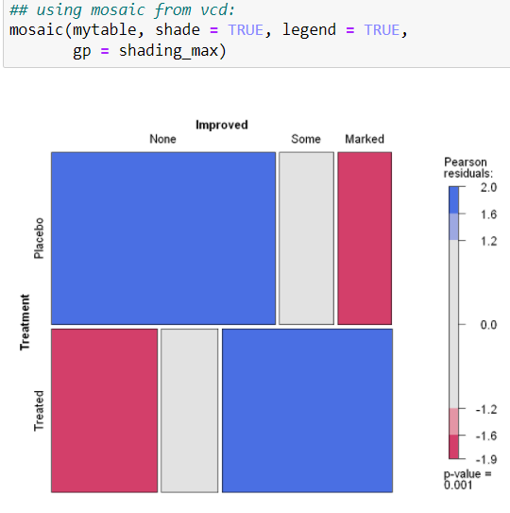
Better Visualization by Mosaic Plot

Slide 27
Chi-squared Test of Homogeneity (卡方齐性检验) (Optional)

Slide 28
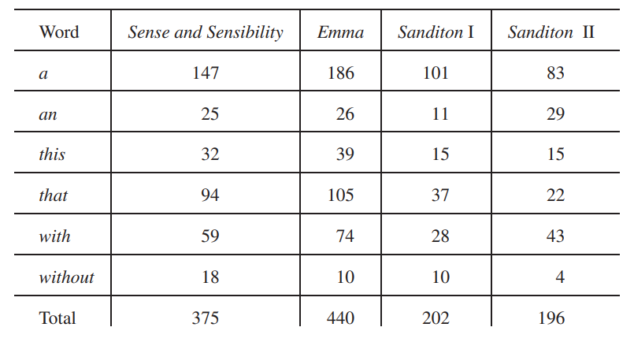
Example: The Sanditon Novel
When Jane Austen died, she left the novel Sanditon only partially completed, but she left a summary of the remainder. A highly literate admirer finished the novel, attempting to emulate Austen’s style, and the hybrid was published.
[Ref: Chapter 13, MSDA3 - J. A. Rice]

Slide 29
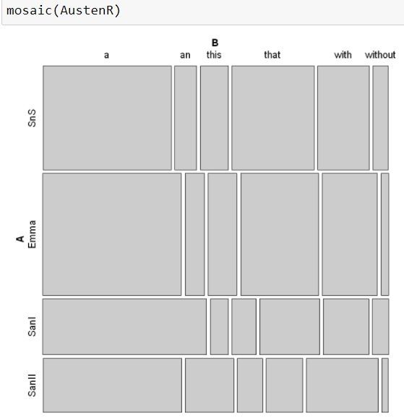
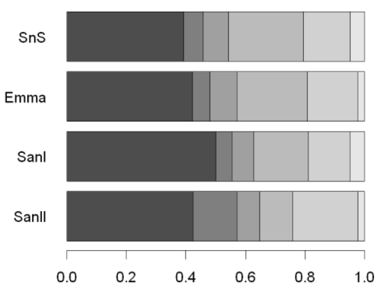
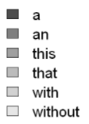
Example: The Sanditon Novel
Q: is there a statistically significant difference of word use?

Slide 30
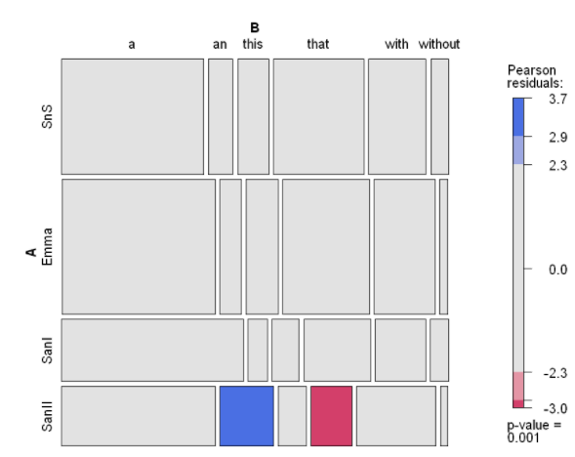
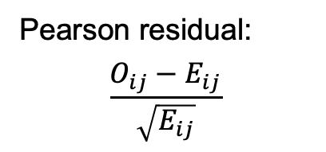
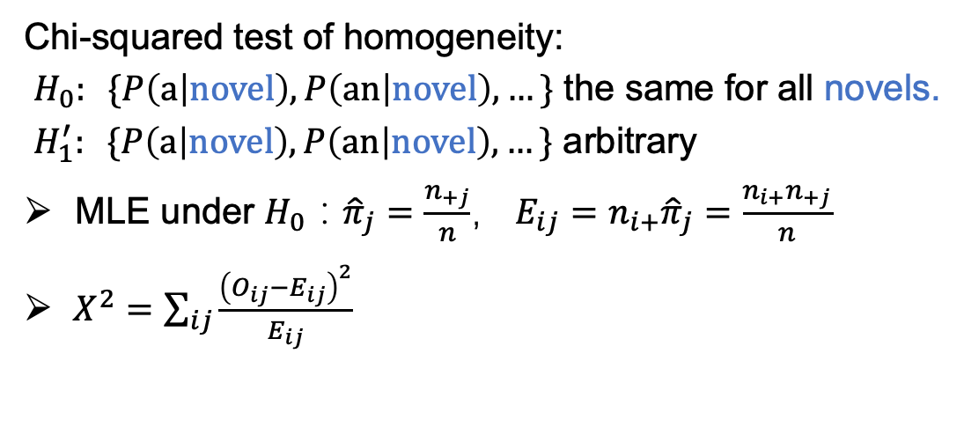
Example: The Sanditon Novel
Chi-squared test of homogeneity:
$H_{0}: \{P\left(a | novel\right),P\left(an | novel\right),…\}$ the same for all novels.
$H_{1}^{′}: \{P\left(a | novel\right),P\left(an | novel\right),…\}$ arbitrary
MLE under $H_{0}$：${\hat{π}}_{j}=\frac{n_{+j}}{n}$，$E_{ij}=n_{i+}{\hat{π}}_{j}=\frac{n_{i+}n_{+j}}{n}$
$X^{2}=\sum_{ij}{\frac{{\left(O_{ij}−E_{ij}\right)}^{2}}{E_{ij}}}$
Operationally, this is the same as Chi-squared test of independence
Pearson residual:
$$\frac{O_{ij}−E_{ij}}{\sqrt{E_{ij}}}$$
Notes:
The Mosaic plot tells you which cells are “responsible” for the significant difference.

Slide 31
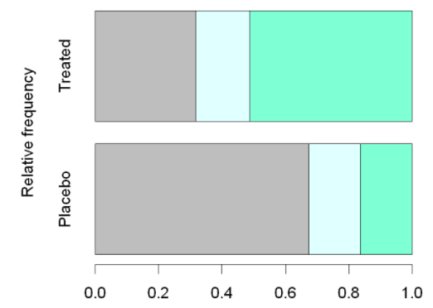





Chi-squared Tests for Different Purposes
Independence
$H_{0}: π_{ij}=π_{i+}π_{+j}$, ($\sum_{ij}{π_{ij}=1}$)
$π_{ij}=P_{XY}\left(i,j\right)=P\left(Y=j|X=i\right)P(X=i)$
$H_{0}→$ $P\left(Y=j|X=i\right)=P(Y=j)=π_{+j}$，independent of $i$
$H_{0}→$ $E_{ij}=\frac{n_{i+}n_{+j}}{n}$
Homogeneity
$H_{0}: \{ρ_{i1},ρ_{i2},ρ_{i3},…,ρ_{iJ}|\sum_{j}{ρ_{ij}=1}\}$ the same for all $i$
$H_{0}→$ $P\left(Y=j|X=i\right)=ρ_{ij}={\tilde{ρ}}_{j}$
$H_{0}→$ $E_{ij}=\frac{n_{i+}n_{+j}}{n}$
Same testing procedures for both cases.
Notes:
Independence: model the joint probability
Homogeneity: model the conditional probability
Main difference: how the sampling is done.

Slide 32



Technical
Input the raw data into R
Raw data is a data frame, where each row is one sample
Create contingency table by attributes as before
Raw data is about the count of each category
Austen.csv

Slide 33

Technical
Input the raw data into R
Raw data is a data frame, where each row is one sample
Create contingency table by attributes as before
Raw data is about the count of each category
R:
data.matrix()
as.table()

